Slide 1
PRAGMA WORKING GROUP NOS
Svein Settemsdal, Jørgen Brekke

Slide 2
110 – 630 DW pipes – PP-HM
E12: year 2003 Dim 110-315mm
Extruder: Inner layer: Cincinnati 75mm 30D
Outer layer: Cincinnati 90mm 30D
Head: Unicor: DWP 270
Corrugator: Unicor UC 250 (315)
E13: year 1987 DIM 200-630mm
Extruder: Inner layer: Reifenhauser 75mm 28D
Outer layer: Reifenhauser 90mm 28D
Head: Frankische
Corrugator: Corma 2020
E14: year 2007 DIM 110-160mm
Extruder: Inner layer: Cincinnati 75mm 37D
Outer layer: Cincinnati 90mm 37D
Head: Frankische
Corrugator: Frankische FDC 160
Material: PP: Borealis BA 202 E
PP-HM: Ineos Resin 350 HM

Slide 3
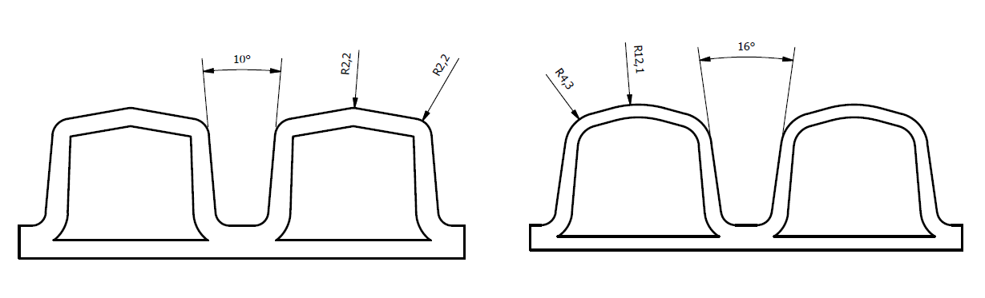
New Pragma line – UC250(315)
Dimension: 110, 200 and 315
ex. DN315
Pragma profile optimizing:
Pitch adapted to new mould blocks
More rounded shape
Angle in valley increased
Optimize profile height
Basically continue with the same seal Except 200 - seal designed

Slide 4
New Pragma line – UC250(315)
 | Weight [kg/m] | Ring-stiffness (kN/m²) Min 8,0 | Impact strength H50, -10°C Min. 1000mm | Ringflex Min 30% | Line speeds [m/min]
DN110 | 0,66 (0,66¹) | 10,70 | 1175 | 40< | 4,5 (7,5¹)
DN200 | 1,80 (1,94²) | 9,67 | 1446 | 40< | 2,5 (1,7²)
DN315 | 4,38 (4,93²) | 10,20 | 1526 | 40< | 1,9³ (1,2²)
¹⁾ – Frankische FDC 160 (50-160)
²⁾ – Corma 2020 (200-630)
³⁾ – Guaranteed line speed. Not run in production yet

Slide 5
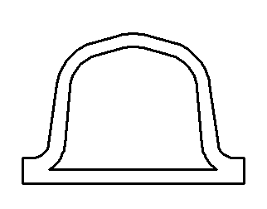
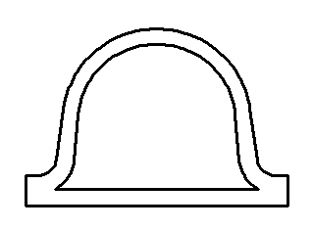
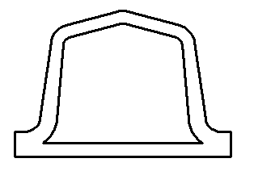
Question: What deffines Pragma?
How rounded can it be? Angles on wall and roof?
Where are the limits?
Are the premises equal for the bigger as for the smaller dimensions?
Hubert Koßner, Unicor, 22/1-15:
„We strongly recommend to use a round profile crest due to improve RF30 behavior”

Slide 6
110-630 DW pipes Line speeds
PP-HM
Pipe | Weight | Line speeds
[mm] | [kg/m] | [m/min] | line
110 | 0,65 | 8,0 | L-14
160 | 1,10 | 6,5 | L-14
200 | 1,80 | 2,5 | L-12
315 | 4,38 | 1,9* | L-12
PP
[mm] | Weight | [m/min] | line
[mm] | [kg/m] | [m/min] | line
400 | 7,86 | 0,97 | L-13
500 | 11,70 | 0,57 | L-13
630 | 19,10 | 0,51 | L-13
*Guaranteed - not run on L12 yet

Slide 7
Further development / potential
L12 - 110 - 315mm - Improve technical stability of the line The line bought used. Installed/startup 2013/14. A lack of previous maintenance causing technical instability.
L13 - 200 - 630mm - New investment of extruders, die head and corrugator Additional dimensions from 630 and up PP- HM on all dimensions Increased output / line speed Reduction of meter weights
- General improvements/ questionaries' for PP/DW production Preheating of material Material savings – Gravimetric dozing – Control speed extr. Inline socketing – corrugator run on L12

